Slide 1
CS 4032 – Web Programming
Dr. Hassan Sartaj

Slide 2
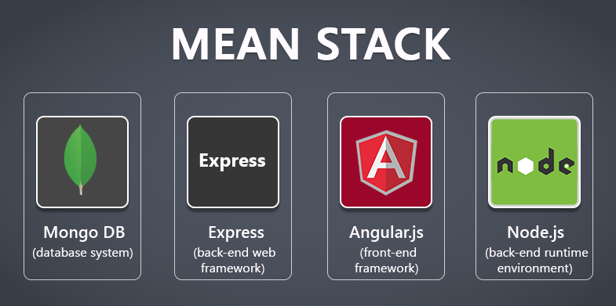
Collection of JavaScript based technologies used to develop web applications.

Slide 3
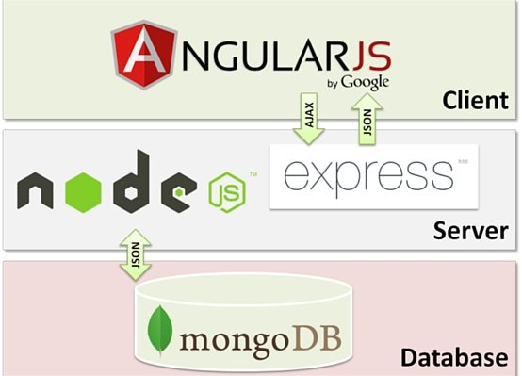
MEAN
M = MongoDB
E = Express
A = Angular.js
N = Node.js

Slide 4
Setting up MEAN Development Environment
MongoDB
Download the latest MongoDB Community Server from MongoDB, and follow the installation guide for your platform (e.g. Windows, MacOS, Ubuntu).
Node.js and NPM Packages
Download and install Node.js 16.x from nodejs.org. We will also need the following global packages:
express-generator for creating web applications using the Express framework.
@angular/cli for creating and building Angular projects.
nodemon for running and monitoring Node.js applications.
To install a package globally (meaning the package will be available to all projects instead of being used by only one project), open a command prompt and run the following command:
npm install -g <package_name> : For example, to install nodemon, simply run "npm install -g nodemon".
Text Editors for Developers
Sublime Text, Visual Studio Code, and Atom are all great code editors and popular among MEAN stack developers. Just pick one that you like the most

Slide 5

Angular
Client Side Application Framework

Slide 6
Introduction
Angular is an open-source web application framework
Based on TypeScript
Mainly maintained by
Google
Community of individuals and corporations
Simplified front-end Development
One platform for Desktop & Mobiles
Address many of the challenges encountered in developing single-page applications
Useful as structural framework for dynamic web apps

Slide 7
Angular: An Application Framework for the Client-Side
Single Page
Application (SPA)
RESTful
Web
Service
Mobile
Application
Desktop
Application

Slide 8
Angular CLI
A command-line tool to create, build, and run Angular applications
For Installation
npm install -g @angular/cli
For Creating Project
ng new <proj>
For run the app
ng serve --open

Slide 9
Angular - TypeScript

Slide 10
TypeScript
TypeScript
ES7 (ES2016)
ES6 (ES2015)
ES5
JavaScript with Type
Makes JavaScript more suitable for large software projects
Static type checking, improved tool support …
Developed by Microsoft
Can be compiled into plain JavaScript
Notes:
ECMAScript is a subset of JavaScript. JavaScript is basically ECMAScript at its core but builds upon it
ECMAScript specification. ES6, ES7,… E8

Slide 11
Compile and Run TypeScript
Install NPM package typescript
npm install -g typescript
Use tsc to compile .ts files to .js
Install NPM package ts-node
Use ts-node to run .ts files directly

Slide 12
ES6 and ES7 Features
Class (ES6 and ES7)
Decorators (ES7)
Configurable decorators
Module (ES6)
Notes:
ECMAScript is a subset of JavaScript. JavaScript is basically ECMAScript at its core but builds upon it
ECMAScript specification. ES6, ES7,… E8

Slide 13
Class Example
Constructor
Static and instance properties
Static and instance initializers
Static and instance methods
Inheritance

Slide 14
Decorators
@Component({
selector: 'app-root',
templateUrl: './app.component.html',
styleUrls: ['./app.component.css']})
Similar to annotations in Java
Add metadata and/or behavior
Types of decorators: class, property, method, and parameter

Slide 15
Class Decorator Example
A class decorator is a function with one argument: the class (or more accurately, the constructor function)
A configurable decorator is a function that takes a config object and returns a regular decorator function
Enable experimentalDecorators option in tsconfig.json or on command line
For Example
@log('hello’)
class World {
}
Notes:
In the example log is invoked using @, and passed a string as a parameter, @log() returns an anonymous function that is the actual decorator.
The decorator function takes a class, or constructor function (ES5) as an argument. The decorator function then returns a new class construction function that is used whenever World is instantiated.
This decorator does nothing other than log out its given parameter, and its target's class name to the console.

Slide 16
TypeScript-Specific Features
Types and type inference
Classes and interfaces
Optional properties
Access modifiers
Abstract class
Interface
Generics
Notes:
Let see various features specific to TypeScript

Slide 17
Basic Types
Primitive types
string
number
boolean
null
undefined
Object types
String
Number
Boolean
Primitive types are automatically converted to object types when necessary

Slide 18
Type Declaration
function factorial(n: number): number {
if (n < 0) throw new Error('Invalid argument');
let result: number = 1;
for (let i: number = 1; i <= n; ++i) result *= i;
return result;
}

Slide 19
Other Commonly Used Types
Array
enum
any
void
let sizes: string[] = ['S', 'M', 'L'];
enum Color {Red, Green, Blue}
let color: Color = Color.Red;
console.log(`color is ${color}`);
console.log(`Blue is ${Color.Blue}`);
function sayHi(): void {
console.log('Hi!');
}

Slide 20
Type Inference
let a = 'hello'; // string
let b = 2.1; // number
let c = [1, 2, 3]; // number[]
let d = ['one', 'two', 3]; //??

Slide 21
Optional Properties
class Foo {
a: number;
b?: number;
}
With strictNullChecks compiler option, a cannot be null or undefined, b can be undefined but not null

Slide 22
Access Modifier in Class
public: default
private: can be accessed within class
protected: can be accessed within class and subclasses
readonly: like const for properties

Slide 23
Parameter Property
class Foobar {
public foo: number;
private bar: number;
constructor( foo: number, bar: number ) {
this.foo = foo;
this.bar = bar;
}
}
Access modifiers are
required for parameter
properties
class Foobar {
constructor( public foo: number, private bar: number ) {}
}

Slide 24
Abstract Class
abstract class Animal {
abstract makeSound(): void;
move(): void {
console.log("roaming the earth...");
}
}

Slide 25
Interface Example
Define interface
Interface inheritance
Interface implementation
interface IEmployee {
empCode: number;
empName: string;
}

Slide 26
The Need for Generics
Generics are often used to ensure that the data in a collection is of the same type
function compare(a, b) : number {…}
class BinaryTreeNode {
value;
left : BinaryTreeNode;
right : BinaryTreeNode;
}

Slide 27
Generic Function and Class
function compare<T>(a : T, b: T) : number {…}
class BinaryTreeNode<T> {
value : T;
left : BinaryTreeNode<T>;
right : BinaryTreeNode<T>;
}
interface Shape {…}
class Circle implements Shape {…}
class Square implements Shape {…}
function area<T extends Shape>(t: T): number {…}
Type
Parameter

Slide 28
Using Generics
Specify a type for the type parameter
result = compare<number>(10, 20);
root = new BinaryTreeNode<string>();

Slide 29
Angular : Modules, Components & Directives

Slide 30
Example: Guest Book (Single Page)
My Guest Book
Add Comment
John says: | Hello! | 4/29/2018
Jane says: | Your website looks nice. | 4/11/2018
Joe says: | Nice to meet you. | 3/5/2018

Slide 31
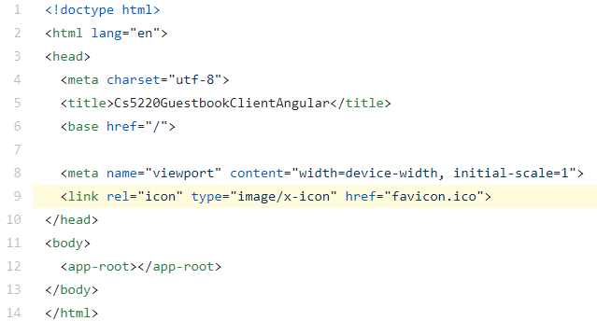
index.html
The "single page" in SPA
The page that hosts all the components such as <app-root>

Slide 32
NgModule: The Angular Module System …
The one-file-per-module approach of CommonJS/ES6 is limiting
file
file
file
file
file
file
file
file

Slide 33
NgModule: The Angular Module System
A NgModule group multiple files (i.e. components, services, and so on) into one module
file
file
file
file
file
file
file
file
NgModule
NgModule

Slide 34
@NgModule …
Each module must export a class that is decorated with @NgModule
declarations: components/directives/pipes that belong to this module
imports: modules which this module depends on
exports: components/directives/pipes that can be used by other modules
providers: injectable objects (usually services) provided by this module
bootstrap: the component(s) to load when this module is used to bootstrap (i.e. to start) an application

Slide 35
About NgModule
declarations and exports deal with components/directives/pipes, i.e. things used in templates
components/directives/pipes can be "private"
services are always "public"
imports deals with modules
imports vs import

Slide 36
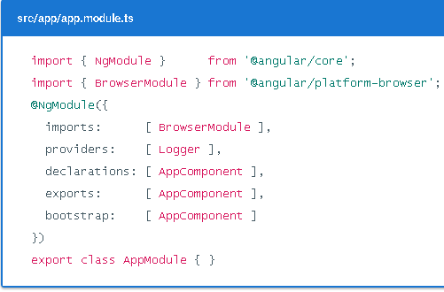
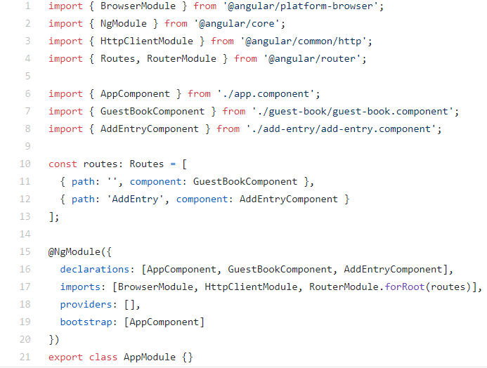
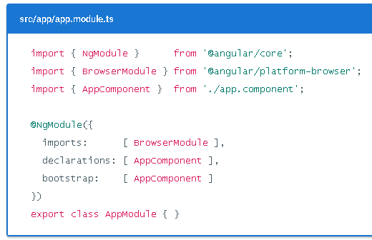
About NgModule

Slide 37
Bootstrap An Application
main.ts :
bootstrapModule(AppModule)
app.module.ts :
bootstrap: [AppComponent]
app.component.html :
<app-guest-book>
GuestBookComponent

Slide 38
Component
User-defined tags as opposed to standard HTML tags like <button>
Appearance: HTML and CSS
Behavior: TypeScript
@ Component
selector: name of the tag
templateUrl or template
styleUrls or styles
More options

Slide 39
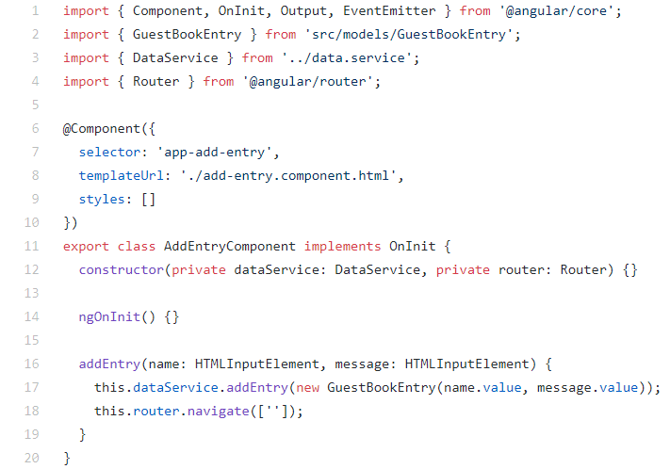
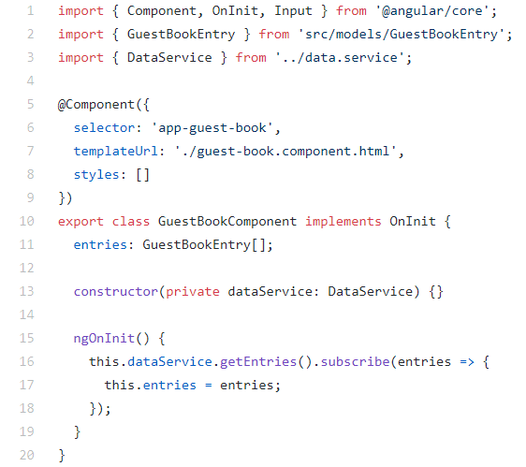
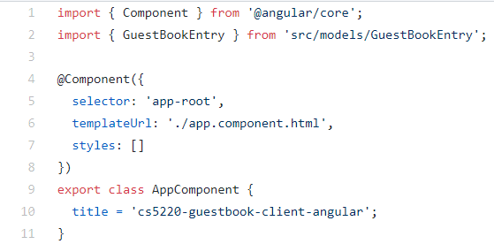
Components - Example

Slide 40
Thank you!

